Slide 1
Communication Case Study
DresSmart Inc.

Slide 2
Agenda
Background
Purpose
Goal
Analysis
Summary

Slide 3
Background V1
Marketing dollars available for annual allocation has been greatly reduced, while sales goals have increased.

Slide 4
Background V2
Market State: DresSmart is experiencing intense margin compression as a result competitive pressure.
Context: Marketing dollars available for annual allocation has been greatly reduced, while sales goals have increased.

Slide 5
Background V3
Market State: DresSmart is experiencing intense margin compression as a result competitive pressure from online competitors.
Enterprise Response: Discretionary budgets across the company have been slashed, and the board has maintained the intermediate sales goals while the 5-year strategic plan is re-evaluated.
Department Context: Marketing dollars available for annual allocation has been greatly reduced, while sales goals have still increased.

Slide 6
Background V4
Market State: DresSmart is experiencing intense margin compression as a result competitive pressure from online competitors.
Enterprise Response: Marketing dollars available for annual allocation has been greatly reduced, while sales goals have increased.
Department Context: Discretionary budgets across the company have been slashed, and the board has maintained the intermediate sales goals while the 5-year strategic plan is re-evaluated.

Slide 7
Purpose V1
The purposes of the analysis is to enable marketing leadership to make better resource allocation decisions, for all future marketing activities. The outcomes that the team wants to achieve is:
Grow Sales
Reduce Marketing costs

Slide 8
Purpose V2
Descriptive
Diagnostic
Predictive
Prescriptive
Given that context, the intent of this analysis is two-fold:
Provide a quantitative framework to facilitate smarter media-mix allocation decisions.
Begin DresSmart’s analytic journey within the marketing vertical.

Slide 9
Purpose V3
The purposes behind this analysis is three-fold:
Grow Sales
Improve Conversion Rate
Reduce Marketing costs

Slide 10
Purpose V4
Build an analytic system to recommend the optimal marketing plan.
Descriptive
Diagnostic
Predictive
Prescriptive

Slide 11
Goal V1
Key Results: Improved YOY performance of marketing activities based on the following metrics:
Sales volume
Effectiveness (volume generated by campaign *units*)
Efficiency (sales volume generated divided by cost)

Slide 12
Goal V2
Key Results: maximize cumulative value generated by customers while minimizing total marketing cost
Sales volume
Effectiveness (volume generated by campaign *units*)
Efficiency (sales volume generated divided by cost)

Slide 13
Goal V3
Grow Sales
Improve Conversion Rate
Reduce Marketing costs

Slide 14
Goal V4
More Sales =
Less Sales =

Slide 15
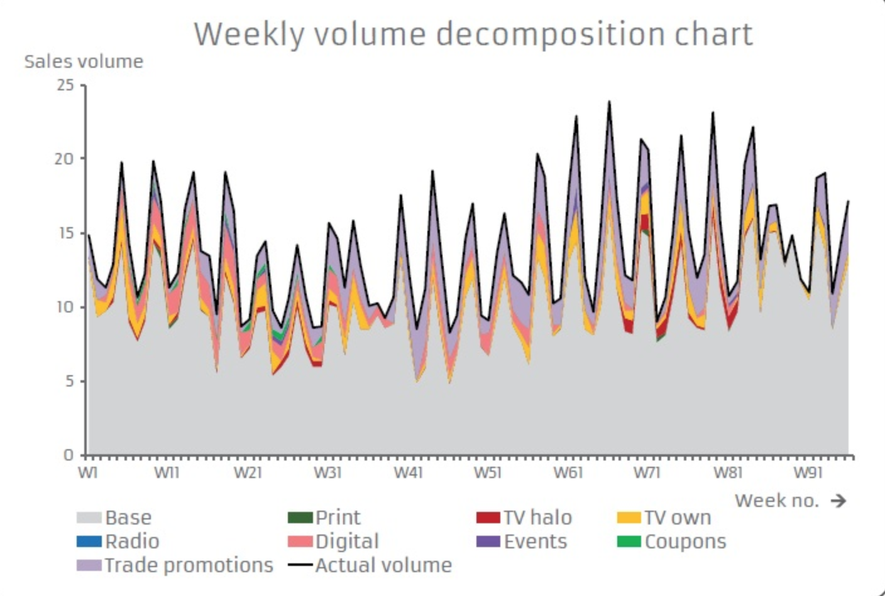
Analysis V1

Slide 16
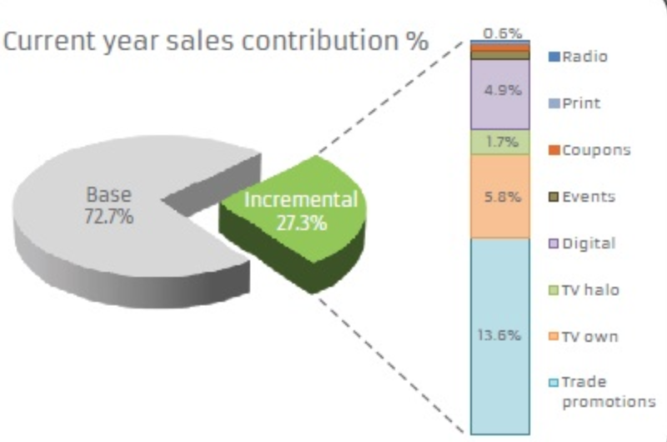
Analysis V2
Using econometric models the team determined that the base –vs- incemental sales from last year is a 72/27 split

Slide 17
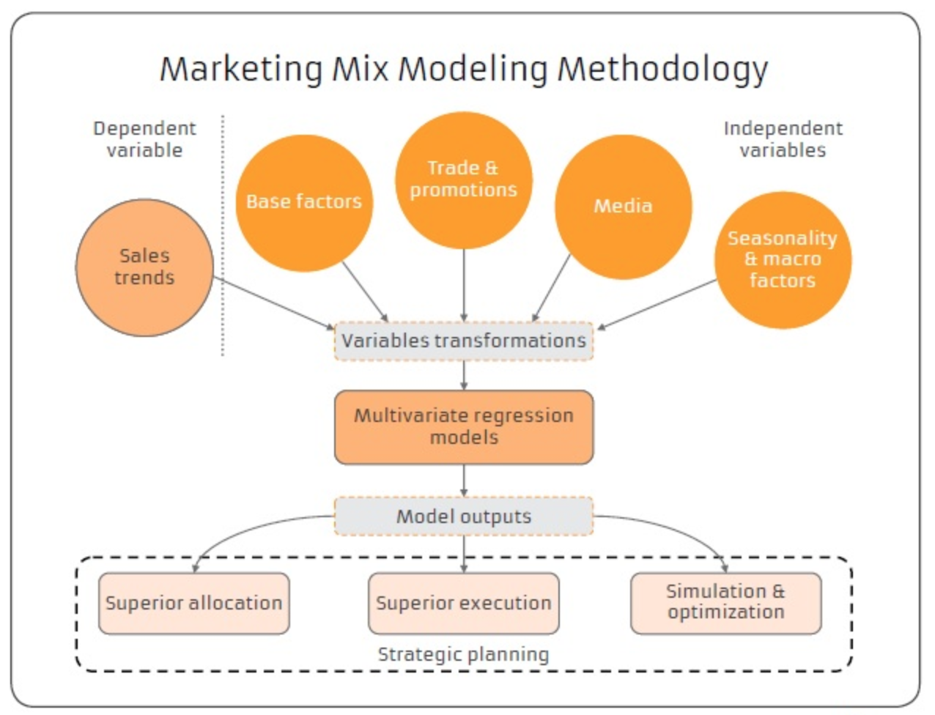
Analysis V3
Plan:
Use traditional regression and econometric techniques to create a MMM of the last 2 years of sales.
Initial Findings:
The analysis suggests that prioritizing paid search and social media digital channels will result in drastically increased effectiveness and efficiency of marketing spend

Slide 18
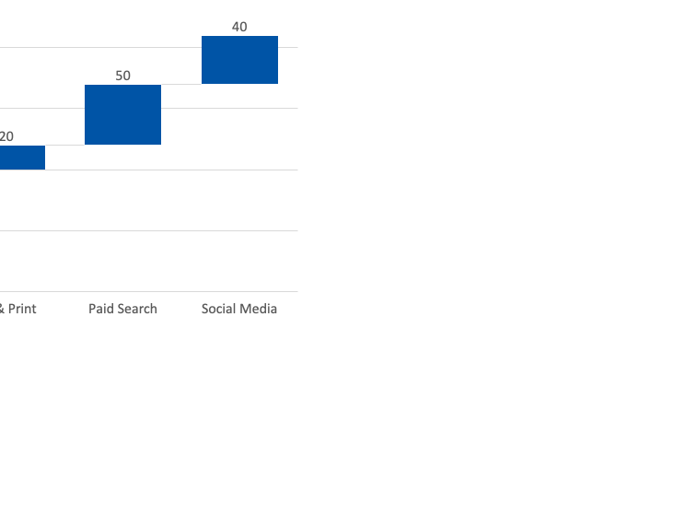
Analysis V4
Plan:
Use traditional regression and econometric techniques to create a Media Mix Model of the last 2 years of sales.
Initial Findings:
The analysis suggests that prioritizing paid search and social media digital channels will result in drastically increased effectiveness and efficiency of marketing spend

Slide 19
Summary V1
Goal:
Improved YOY performance of marketing activities based on the following metrics:
Sales volume
Effectiveness
Efficiency
The analysis suggests that prioritizing paid search and social media digital channels will result in drastically increased effectiveness and efficiency of marketing spend. Increasing total volume may be unrealistic given budget constraints.

Slide 20
Summary V2
Goal:
Improved YOY performance of marketing activities based on the following metrics:
Sales volume
Effectiveness
Efficiency
Recommendation:
Allocate the remaining TV & Print budget for 2020 into ‘Paid Search’ and ‘Social Media’ channels until the ‘cost per sale’ for those channels is equal to TV & Print.
Expected Outcomes:
Marketing ‘Effectiveness’ and ‘Efficiency’ is expected improve with this strategy, although it will be un-realistic to expect total sales to increase given the base-line to incremental split.
Channel | Cost per Sale
TV & Print | $15.00
Paid Search | $7.80
Social Media | $6.20

Slide 21



Summary V3
Goal:
Improved YOY performance of marketing activities based on the following metrics:
Sales volume
Effectiveness
Efficiency
Recommendation:
Allocate the remaining TV & Print budget for 2020 into ‘Paid Search’ and ‘Social Media’ channels until the ‘cost per sale’ for those channels is equal to TV & Print. This will take advantage of the increased return given by those channels
Expected Outcomes:
Marketing ‘Effectiveness’ and ‘Efficiency’ is expected improve with this strategy, although it will be un-realistic to expect total sales to increase given the base-line to incremental split.
TV & Print - $15 Cost per Sale
Paid Search - $7.8 Cost per Sale
Social Media - $6.2 Cost per Sale

Slide 22
Summary V2
Recommendation:
Allocate the remaining TV & Print budget for 2020 into ‘Paid Search’ and ‘Social Media’ channels until the ‘cost per sale’ for those channels is equal to TV & Print.
Channel | Cost per Sale
TV & Print | $15.00
Paid Search | $7.80
Social Media | $6.20

